Slide 1
Chapter 2. Data, Measurements, and Data Preprocessing
Data Types
Statics of Data
Similarity and Distance Measures
Data Quality, Data Cleaning and Data Integration
Data Transformation
Dimensionality Reduction
Summary

Slide 2
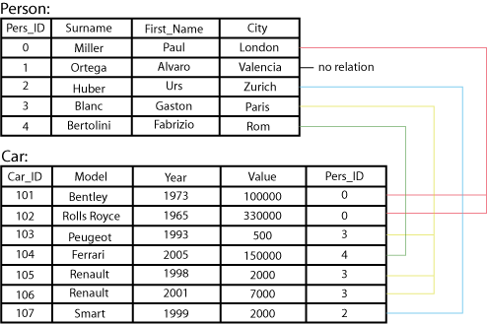
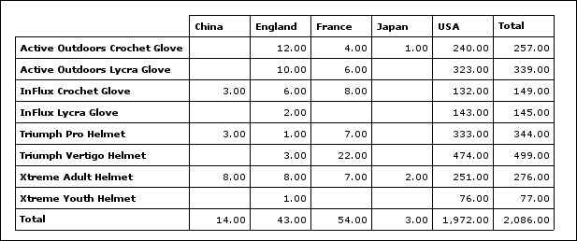
Types of Data Sets: (1) Record Data
Relational records
Relational tables, highly structured
Data matrix, e.g., numerical matrix, crosstabs
Transaction data
Document data: Term-frequency vector (matrix) of text documents

Slide 3


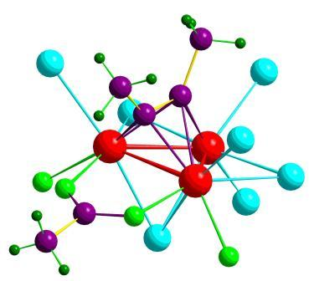

Types of Data Sets: (2) Graphs and Networks
Transportation network
World Wide Web
Molecular Structures
Social or information networks

Slide 4

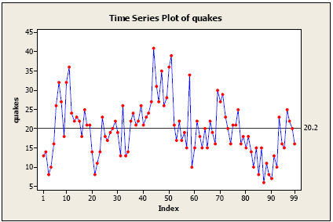
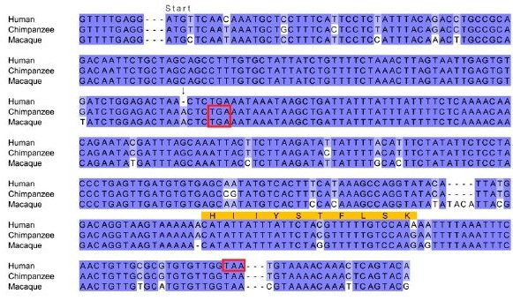
Types of Data Sets: (3) Ordered Data
Video data: sequence of images
Temporal data: time-series
Sequential Data: transaction sequences
Genetic sequence data

Slide 5
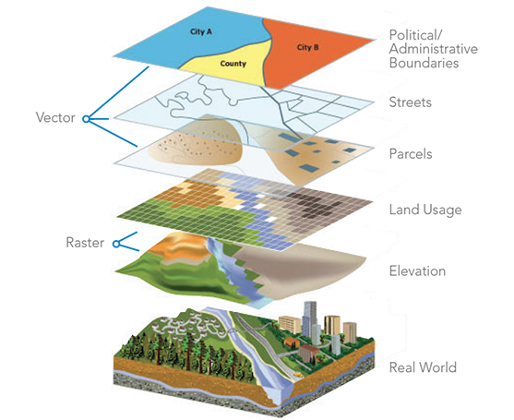

Types of Data Sets: (4) Spatial, image and multimedia Data
Spatial data: maps
Image data:
Video data:

Slide 6
Important Characteristics of Structured Data
Dimensionality
Curse of dimensionality
Sparsity
Only presence counts
Resolution
Patterns depend on the scale
Distribution
Centrality and dispersion
Notes:
Curse of dimensionality – If number of features increases which happens in a large dataset, then it becomes difficult to find meaningful patterns.
e.g- A company has dataset with 1000 customers and it has 3 features : Age, income, number of purchases. With these 3 features, it is very easy to visualize and analyze the data.
Now if the company decides to include more features to improve analysis such as gender, location, purchase frequency, preferred payment method, shopping time.
This will increase sparsity. Imagine trying to cluster customers based on 50 features; the distance between any two customers becomes large, and the data points appear sparse. This sparsity makes it harder to identify meaningful clusters or patterns because there’s not enough data density in any given region of the space.

Slide 7
Data Objects
Data sets are made up of data objects
A data object represents an entity
Examples:
sales database: customers, store items, sales
medical database: patients, treatments
university database: students, professors, courses
Also called samples , examples, instances, data points, objects, tuples
Data objects are described by attributes
Database rows → data objects; columns → attributes

Slide 8
Attributes
Attribute (or dimensions, features, variables)
A data field, representing a characteristic or feature of a data object.
E.g., customer _ID, name, address
Types:
Nominal (e.g., red, blue)
Binary (e.g., {true, false})
Ordinal (e.g., {freshman, sophomore, junior, senior})
Numeric: quantitative
Interval-scaled: 100○C is interval scales
Ratio-scaled: 100○K is ratio scaled since it is twice as high as 50 ○K
Discrete vs. Continuous Attributes
Notes:
Attribute : Characteristic of an object that may vary. E.g- Eye color varies from person to person.
Nominal, Binary, Ordinal are non-numeric attributes.

Slide 9
Attribute Types
Nominal: categories, states, or “names of things”
Hair_color = {auburn, black, blond, brown, grey, red, white}
country, occupation, ID numbers, zip codes, animal types
Binary
Special case of nominal attribute with only 2 states (0 and 1)
Symmetric binary: both outcomes equally important
e.g., gender
Asymmetric binary: outcomes not equally important.
e.g., medical test (positive vs. negative)
Convention: assign 1 to most important outcome (e.g., HIV positive)
Ordinal
Values have a meaningful order (ranking) but magnitude between successive values is not known
Size = {small, medium, large}, grades, military rankings (Private, Corporal, Sergeant), education levels, survey ratings (Poor, fair, good, excellent)
Notes:
Nominal : Represents distinct categories without any ranking between them.
Binary : The values represent the presence or absence of a characteristic, a yes/no situation, or two categories that are mutually exclusive. E.g-Has Driver's License: {Yes, No}, Is Married: {True, False}.
Ordinal : Represent categories or labels, but unlike nominal attributes, there is a meaningful order or ranking among the categories.

Slide 10
Numeric Attribute Types
Quantity (integer or real-valued)
Interval
Measured on a scale of equal-sized units
Values have order
E.g., temperature in C˚or F˚, calendar dates
Difference between values is meaningful but no true zero-point.
Ratio
Inherent zero-point
Both the differences and the ratios between values are meaningful.
We can speak of values as being an order of magnitude larger than the unit of measurement (10 K˚ is twice as high as 5 K˚).
e.g., temperature in Kelvin, length, counts, monetary quantities
Notes:
Interval attribute : Difference between values is meaningful, but there is no true zero point (i.e., zero does not represent the absence of the quantity being measured). In interval attributes, you can perform operations like addition and subtraction, but multiplication and division are not meaningful.
Consider temperatures like 10°C, 20°C, and 30°C. The difference between 30°C and 20°C is the same as the difference between 20°C and 10°C, which is 10°C. This makes the differences meaningful.
However, 0°C does not represent an absence of temperature; it is simply a point on the temperature scale.
Dates (another example of interval): The difference between two dates, such as the difference between January 1st, 2000, and January 1st, 2020, is meaningful (20 years), but there is no "zero date.“
Ratio attribute: Both the differences and the ratios between values are meaningful. Ratio attributes have a true zero point.
The difference between 150 kg and 100 kg is the same as the difference between 100 kg and 50 kg, which is 50 kg. This makes the differences meaningful.
Additionally, a weight of 0 kg means there is no weight, which is a true zero point.

Slide 11
Discrete vs. Continuous Attributes
Discrete Attribute
Has only a finite or countably infinite set of values
E.g., Days of week, Shoe size
Sometimes, represented as integer variables
Note: Binary attributes are a special case of discrete attributes
Continuous Attribute
Can take any value within a range. Includes fractions and decimals.
E.g., temperature, height, or weight
Practically, real values can only be measured and represented using a finite number of digits
Continuous attributes are typically represented as floating-point variables
Notes:
Discrete Attribute : e.g - Number of Children: You can have 0, 1, 2, 3, etc., but not 2.5 children; Days of the Week: {Monday, Tuesday, Wednesday, …, Sunday}.
Continuous Attribute : e.g- Height can be 170.2 cm, 180.5 cm, etc; Weight can be 60.5 kg, 72.3 kg, etc.,

Slide 12
Statistics of Data
Measuring the Central Tendency
Measuring the Dispersion of Data
Covariance and Correlation Analysis
Graphic Displays of Basic Statistics of Data

Slide 13
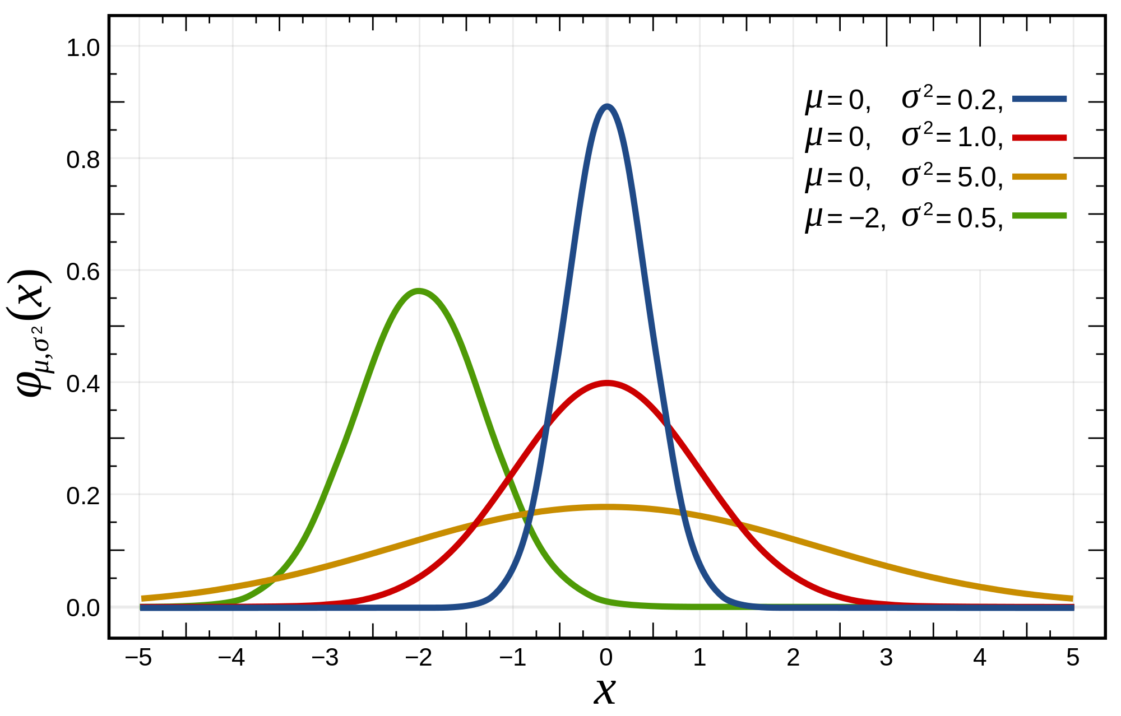
Basic Statistical Descriptions of Data
Motivation
To better understand the data: central tendency, variation and spread
Data dispersion characteristics
Median, max, min, quantiles, outliers, variance, ...
Numerical dimensions correspond to sorted intervals
Data dispersion:
Analyzed with multiple granularities of precision
Boxplot or quantile analysis on sorted intervals
Dispersion analysis on computed measures
Folding measures into numerical dimensions
Boxplot or quantile analysis on the transformed cube

Slide 14
Measuring the Central Tendency: (1) Mean
Mean (algebraic measure) (sample vs. population):
Note: n is sample size and N is population size.
Weighted arithmetic mean:
Trimmed mean:
Chopping extreme values (e.g., Olympics gymnastics score computation)

Slide 15
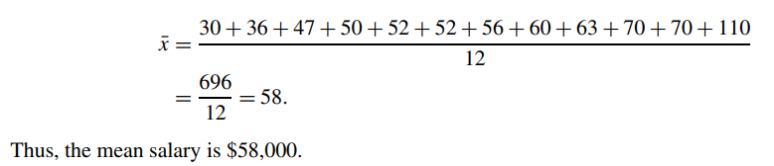
Example problem on mean
Suppose we have the following values for salary (in thousands of dollars), shown
in ascending order: 30, 36, 47, 50, 52, 52, 56, 60, 63, 70, 70, 110. Find the mean salary.

Slide 16
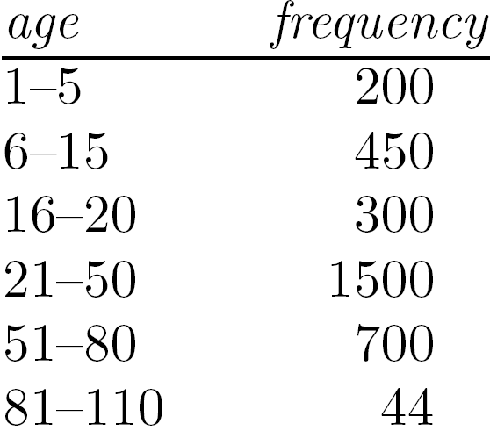
Measuring the Central Tendency: (2) Median
Median:
Middle value if odd number of values, or average of the middle two values otherwise
Estimated by interpolation (for grouped data):
Approximate median
Sum before the median interval
Interval width (L₂ – L₁)
Low interval limit

Slide 17
Example problem
Suppose we have the following values for salary (in thousands of dollars), shown
in ascending order: 30, 36, 47, 50, 52, 52, 56, 60, 63, 70, 70, 110. Find the median salary.
There is an even number of observations (i.e., 12); therefore, the median is not unique. It can be any value within the two middlemost values of 52 and 56 (that is, within the sixth and seventh values in the list).
By convention, we assign the average of the two middlemost values as the median; that is, 52+56/2=108/2=54.
Thus, the median is $54,000.

Slide 18
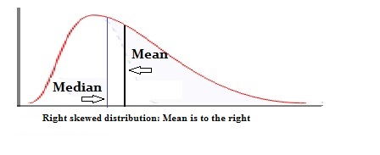
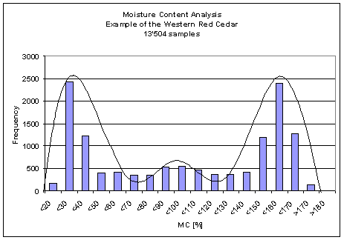
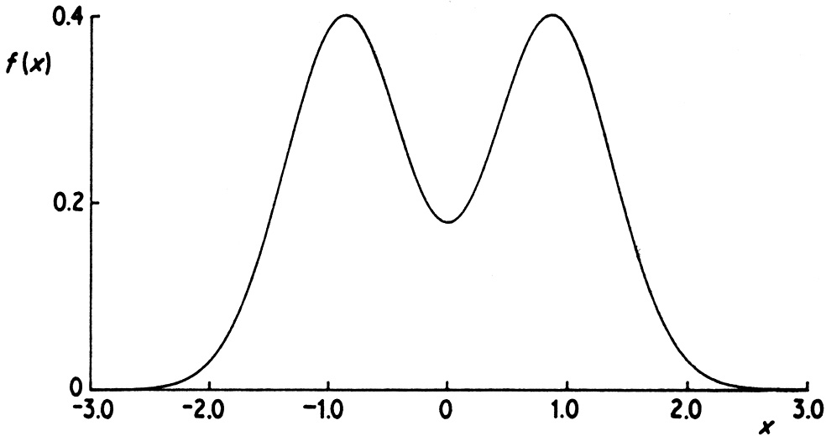
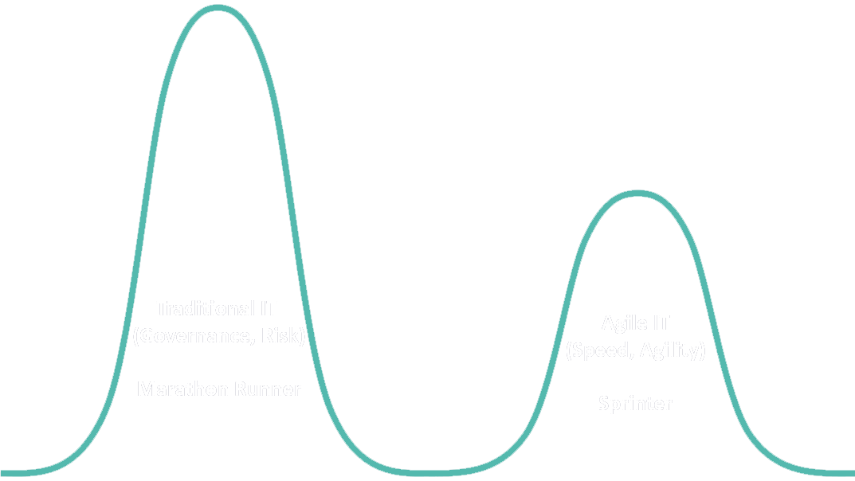
Measuring the Central Tendency: (3) Mode
Mode: Value that occurs most frequently in the data
Unimodal
Empirical formula:
Multi-modal
Bimodal
Trimodal

Slide 19
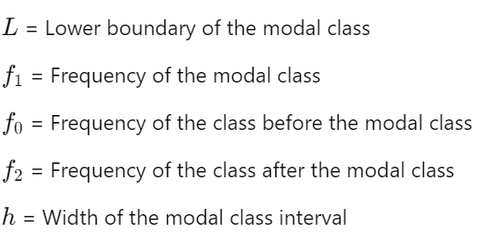
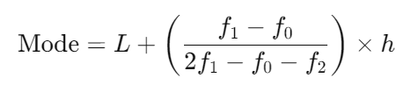
Calculation of mode for the grouped data
The modal class is the class interval with the highest frequency.

Slide 20
Example problem on mode
Suppose we have the following values for salary (in thousands of dollars), shown
in ascending order: 30, 36, 47, 50, 52, 52, 56, 60, 63, 70, 70, 110. Find the mode.
The salaries 52,000 and 70,000 occur twice. Hence the data is bimodal. The two modes are $52,000 and $70,000.

Slide 21
Example problem
Suppose we have the following values for age in a group of people, shown
in ascending order: 5, 4, 10, 2, 9. Find the mean, median and mode.

Slide 22
Solution
Suppose we have the following values for age in a group of people, shown
in ascending order: 5, 4, 10, 2, 9. Find the mean, median and mode.
Mean : 5+4+10+2+9/5 = 30/5 =6
Median : The dataset in ascending order will be 2,4,5,9,10. Since there are 5 numbers in the dataset (an odd number of observations), the median is the middle value. The median is 5.
Mode : In this dataset, each number appears only once. Hence, there is no mode for this dataset.

Slide 23
Symmetric vs. Skewed Data
Positively skewed : The mode occurs at a value that is smaller than the median.
Negatively skewed : The mode occurs at a value greater than the median.

Slide 24
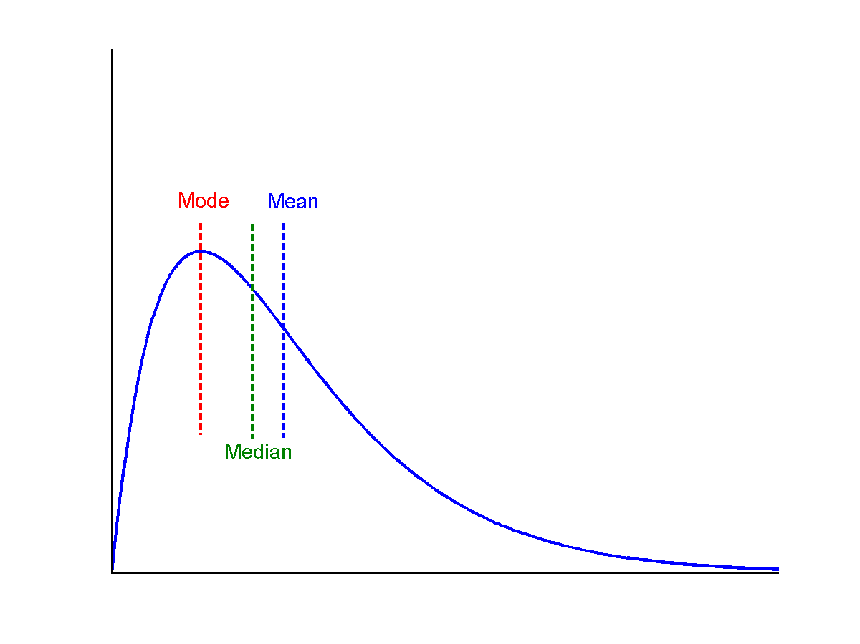
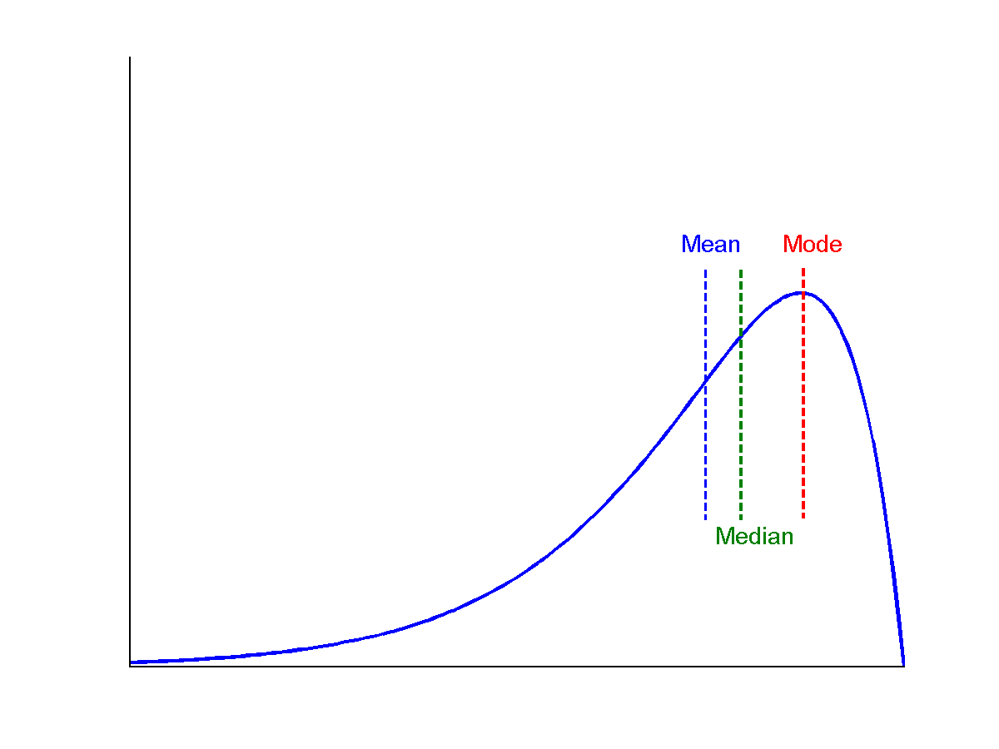
Median, mean and mode of symmetric, positively and negatively skewed data
positively skewed
negatively skewed
symmetric

Slide 25
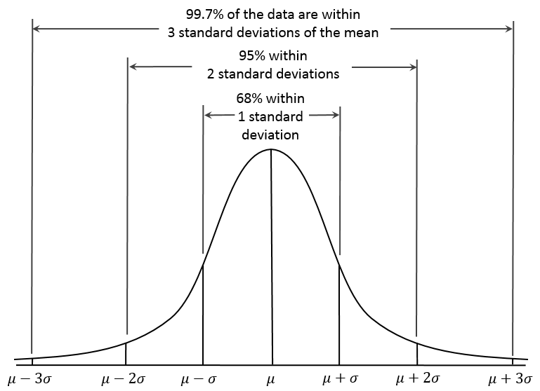
Properties of Normal Distribution Curve
← — ————Represent data dispersion, spread — ————→
Represent central tendency

Slide 26
Measures Data Distribution: Variance and Standard Deviation
Variance and standard deviation (sample: s, population: σ)
Variance: (algebraic, scalable computation)
Q: Can you compute it incrementally and efficiently?
Standard deviation s (or σ) is the square root of variance s² ⁽or σ²⁾
Note: The subtle difference of formulae for sample vs. population
n : the size of the sample
N : the size of the population

Slide 27
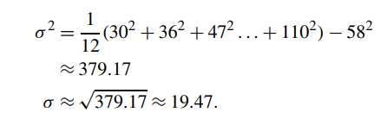
Example problem : Variance and Standard Deviation
Suppose we have the following values for salary (in thousands of dollars), shown
in ascending order: 30, 36, 47, 50, 52, 52, 56, 60, 63, 70, 70, 110. Find the variance and standard deviation.
Mean = 58

Slide 28

Variance for Single Variable (Numerical Data)
The variance of a random variable X provides a measure of how much the value of X deviates from the mean or expected value of X:
where σ² is the variance of X, σ is called standard deviation
µ is the mean, and µ = E[X] is the expected value of X
That is, variance is the expected value of the square deviation from the mean
It can also be written as:
Sample variance
$$s^{2}=\frac{1}{n}\sum_{i}^{n}{{\left(x_{i}−\hat{μ}\right)}^{2}} s^{2}=\frac{1}{n−1}\sum_{i}^{n}{{\left(x_{i}−\hat{μ}\right)}^{2}}$$

Slide 29
Similarity and Distance Measures
Data Matrix versus Dissimilarity Matrix
Proximity Measures for Nominal Attributes
Proximity Measures for Binary Attributes
Dissimilarity of Numeric Data: Minkowski Distance
Proximity Measures for Ordinal Attributes
Dissimilarity for Attributes of Mixed Types
Cosine Similarity

Slide 30
Similarity, Dissimilarity, and Proximity
Similarity measure or similarity function
A real-valued function that quantifies the similarity between two objects
Measure how two data objects are alike: The higher value, the more alike
Often falls in the range [0,1]: 0: no similarity; 1: completely similar
Dissimilarity (or distance) measure
Numerical measure of how different two data objects are
In some sense, the inverse of similarity: The lower, the more alike
Minimum dissimilarity is often 0 (i.e., completely similar)
Range [0, 1] or [0, ∞) , depending on the definition
Proximity usually refers to either similarity or dissimilarity

Slide 31
Data Matrix and Dissimilarity Matrix
Data matrix
A data matrix of n data points with l dimensions
Dissimilarity (distance) matrix
n data points, but registers only the distance d(i, j) (typically metric)
Usually symmetric, thus a triangular matrix
Distance functions are usually different for real, boolean, categorical, ordinal, ratio, and vector variables
Weights can be associated with different variables based on applications and data semantics

Slide 32
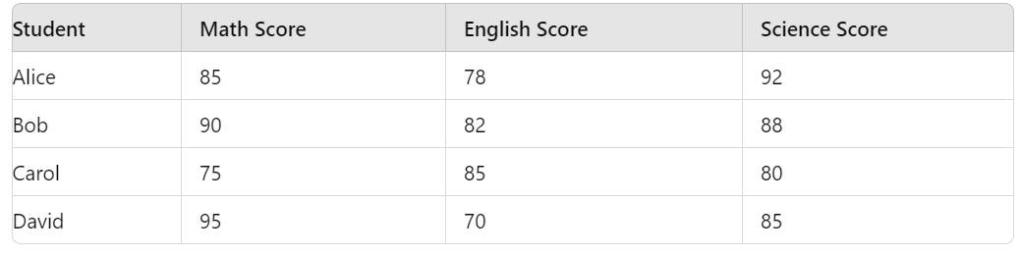
Data Matrix Example
Consider a dataset of students where we measure their scores in three subjects: Math, English, and Science.
Notes:
Purpose of Data Matrix : The data matrix is used to store and organize raw data for analysis. It’s the starting point for many types of analysis, including statistical analysis, machine learning, and more.

Slide 33
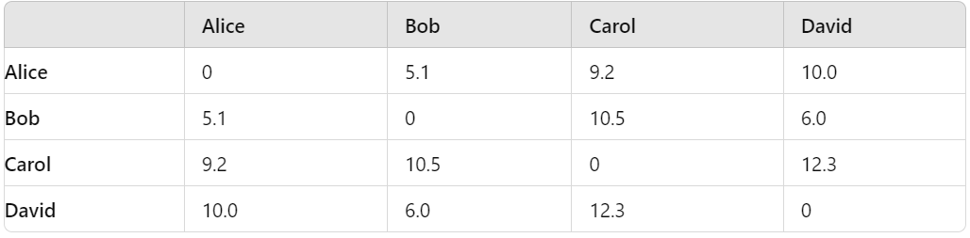
Dissimilarity Matrix Example
Using the same dataset of students, we calculate the Euclidean distance between their scores.
Notes:
Purpose of Dissimilarity Matrix : Used to analyze the pairwise differences between data points, often for clustering, classification, or dimensionality reduction tasks. It is particularly useful in algorithms like k-means clustering, hierarchical clustering, or multidimensional scaling (MDS).

Slide 34
Standardizing Numeric Data
Z-score:
X: raw score to be standardized, μ: mean of the population, σ: standard deviation
the distance between the raw score and the population mean in units of the standard deviation
negative when the raw score is below the mean, “+” when above
An alternative way: Calculate the mean absolute deviation
Where,
standardized measure (z-score):
Using mean absolute deviation is more robust than using standard deviation
Notes:
MK: For lecture, this may be OK here, but I think discussion of standardization/normalization is better kept all together in Chapter 3

Slide 35
Example: Data Matrix and Dissimilarity Matrix
Data Matrix
Dissimilarity Matrix (by Euclidean Distance)

Slide 36
Distance on Numeric Data: Minkowski Distance
Minkowski distance: A popular distance measure
where i = (x_{i1}, x_{i2}, …, x_{il}) and j = (x_{j1}, x_{j2}, …, x_{jl}) are two l-dimensional data objects, and p is the order (the distance so defined is also called L-p norm)
Properties
d(i, j) > 0 if i ≠ j, and d(i, i) = 0 (Positivity)
d(i, j) = d(j, i) (Symmetry)
d(i, j) ≤ d(i, k) + d(k, j) (Triangle Inequality)
A distance that satisfies these properties is a metric
Note: There are nonmetric dissimilarities, e.g., set differences

Slide 37
Special Cases of Minkowski Distance
p = 1: (L₁ norm) Manhattan (or city block) distance
E.g., the Hamming distance: the number of bits that are different between two binary vectors
p = 2: (L₂ norm) Euclidean distance
p → ∞: (L_{max} norm, L∞ norm) “supremum” distance
The maximum difference between any component (attribute) of the vectors

Slide 38
Example: Minkowski Distance at Special Cases
Manhattan (L₁)
Euclidean (L₂)
Supremum (L∞)
Notes:
L1 and L2 norm needed because they are part of machine learning.

Slide 39
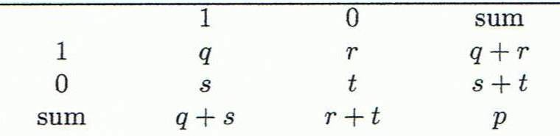
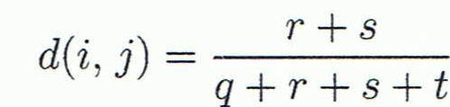
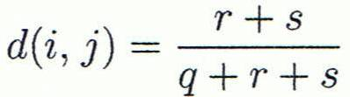
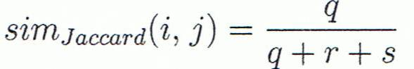
Proximity Measure for Binary Attributes
A contingency table for binary data
Distance measure for symmetric binary variables:
Distance measure for asymmetric binary variables:
Jaccard coefficient (similarity measure for asymmetric binary variables):
Note: Jaccard coefficient is the same as “coherence”:
Object j
Object i
(a concept discussed in Pattern Discovery)

Slide 40
Example: Dissimilarity between Asymmetric Binary Variables
Mary
 | 1 | 0 | ∑_{row}
1 | 2 | 0 | 2
0 | 1 | 3 | 4
∑_{col} | 3 | 3 | 6
Jack
Gender is a symmetric attribute (not counted in)
The remaining attributes are asymmetric binary
Let the values Y and P be 1, and the value N be 0
Distance:
Jim
 | 1 | 0 | ∑_{row}
1 | 1 | 1 | 2
0 | 1 | 3 | 4
∑_{col} | 2 | 4 | 6
Jack
Mary
 | 1 | 0 | ∑_{row}
1 | 1 | 1 | 2
0 | 2 | 2 | 4
∑_{col} | 3 | 3 | 6
Jim

Slide 41
Proximity Measure for Categorical Attributes
Categorical data, also called nominal attributes
Example: Color (red, yellow, blue, green), profession, etc.
Method 1: Simple matching
m: # of matches, p: total # of variables
Method 2: Use a large number of binary attributes
Creating a new binary attribute for each of the M nominal states

Slide 42
Ordinal Variables
An ordinal variable can be discrete or continuous
Order is important, e.g., rank (e.g., freshman, sophomore, junior, senior)
Can be treated like interval-scaled
Replace an ordinal variable value by its rank:
Map the range of each variable onto [0, 1] by replacing i-th object in the f-th variable by
Example: freshman: 0; sophomore: 1/3; junior: 2/3; senior 1
Then distance: d(freshman, senior) = 1, d(junior, senior) = 1/3
Compute the dissimilarity using methods for interval-scaled variables

Slide 43
Attributes of Mixed Type
A dataset may contain all attribute types
Nominal, symmetric binary, asymmetric binary, numeric, and ordinal
One may use a weighted formula to combine their effects:
If f is numeric: Use the normalized distance
If f is binary or nominal: d_{ij}^{(f)} = 0 if x_{if} = x_{jf}; or d_{ij}^{(f)} = 1 otherwise
If f is ordinal
Compute ranks z_{if} (where )
Treat z_{if} as interval-scaled

Slide 44
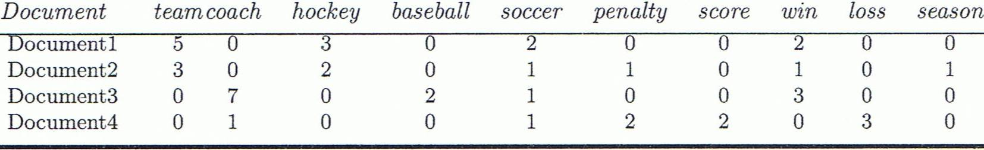
Cosine Similarity of Two Vectors
A document can be represented by a bag of terms or a long vector, with each attribute recording the frequency of a particular term (such as word, keyword, or phrase) in the document
Other vector objects: Gene features in micro-arrays
Applications: Information retrieval, biologic taxonomy, gene feature mapping, etc.
Cosine measure: If d₁ and d₂ are two vectors (e.g., term-frequency vectors), then
where • indicates vector dot product, ||d||: the length of vector d

Slide 45
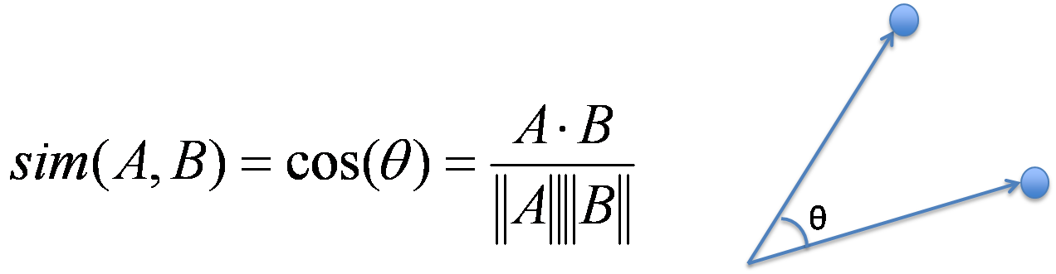
Example: Calculating Cosine Similarity
Calculating Cosine Similarity:
where • indicates vector dot product, ||d||: the length of vector d
Ex: Find the similarity between documents 1 and 2.
d₁ = (5, 0, 3, 0, 2, 0, 0, 2, 0, 0) d₂ = (3, 0, 2, 0, 1, 1, 0, 1, 0, 1)
First, calculate vector dot product
d₁•d₂ = 5 X 3 + 0 X 0 + 3 X 2 + 0 X 0 + 2 X 1 + 0 X 1 + 0 X 1 + 2 X 1 + 0 X 0 + 0 X 1 = 25
Then, calculate ||d₁|| and ||d₂||
Calculate cosine similarity: cos(d₁, d₂ ) = 25/ (6.481 X 4.12) = 0.94

Slide 46
Summary
Data types and attribute types
Nominal, binary, ordinal, numerical, discrete vs. continuous attributes
Statistics of data
Central tendency, dispersion
Measure data similarity and correlation
Proximity measures for nominal, binary, numerical, ordinal types
Cosine similarity

